Slide 1
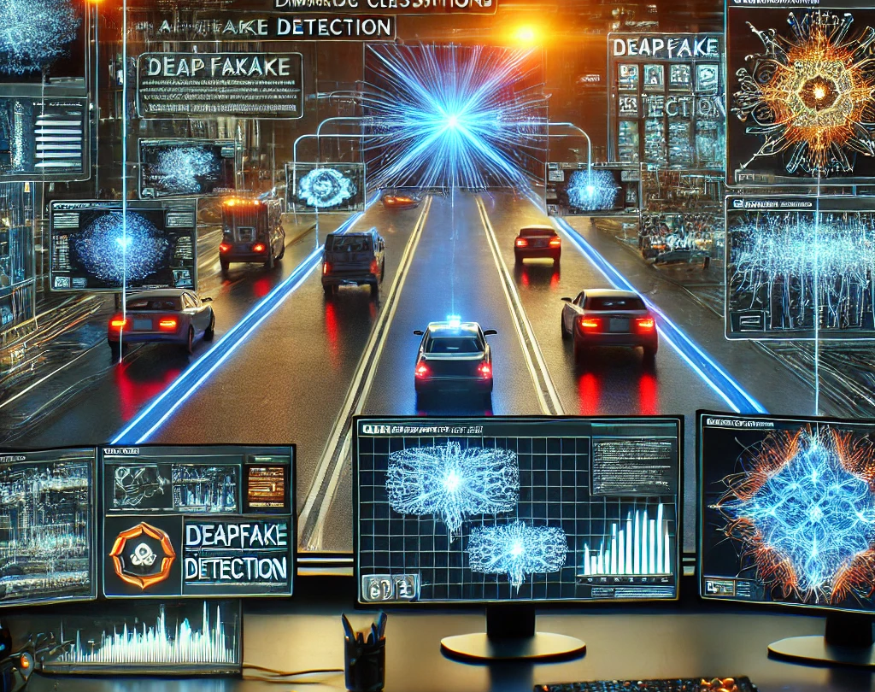
Interactive Labs for Machine Learning Cybersecurity
By
Deekshith Machidi - 2246684
Monish Kamal Batini - 2250471
Ajay Kumar Reddy Poreddy - 2247259
Vinay Kumar Posina - 2248768

Slide 2
Introduction
Machine learning has boosted system efficiency but also introduced new security risks.
AI-driven interactions bring added vulnerabilities, and cyber-attacks powered by AI are growing more advanced and harder to detect.

Slide 3

AI Threats in Cybersecurity
Detection Evasion
Impersonation
Deepfake Creation
Adversarial Attacks
Data Poisoning
Misleading AI Models
Manipulation of AI-Driven Systems

Slide 4
Real-World Examples
Tesla Autopilot exploited to mislead vehicle behavior
Adversarial inputs confuse AI models (traffic signals).
Facial recognition systems fooled by designed eyewear
Voice Assistants by Manipulated Audio Inputs
Image recognition in medical areas (manipulating the reports).
Security cameras by altering the visuals
Robotics (abnormal behavior by wrong commands)
Financial Systems (disabling the fraud transactions or manipulating the transaction receipts)

Slide 5

Recent technology threat
Altering the photos:
Latest release version of the Google Pixel 9 series have introduced Add me feature which make people easy to add another person or thing into the existing photos
Add me feature

Slide 6
Types of security incidents
Unauthorized access
Malware attacks
Zero-day attacks
Data breaches
Phishing

Slide 7
Objective and Goal
Objective:
Create labs for hands-on experience in AI threat mitigation.
Goals:
Increase knowledge of machine learning vulnerabilities.
Develop stronger detection and defense mechanisms.

Slide 8

Expected Outcome
The project addresses the growing challenges in AI cybersecurity by training users with hands-on experience through interactive labs that simulate real-world threats.

Slide 9
Queries
What kind of security incidents are we dealing in this project?
What are the interactive labs ?

Slide 10

THANK YOU

